Slide 1
CAM: Assignment
Omar Elsewify
MAZE Assignment – October 13 2020

Slide 2
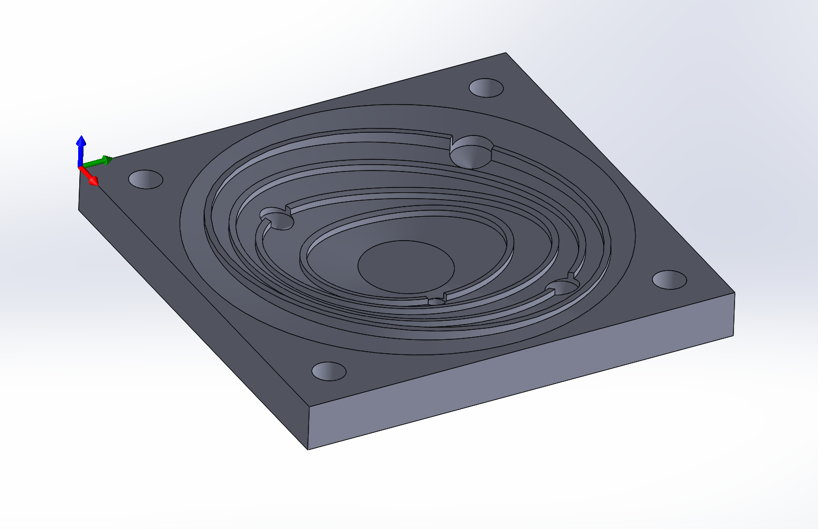
Initial MAZE CAD
KEY FEATURES
Slanted face to mimic the gravitational pull of the sun
Divot holes to replicate planet gravitational pull
4 orbit shaped walls extruding from the slanted surface

Slide 3
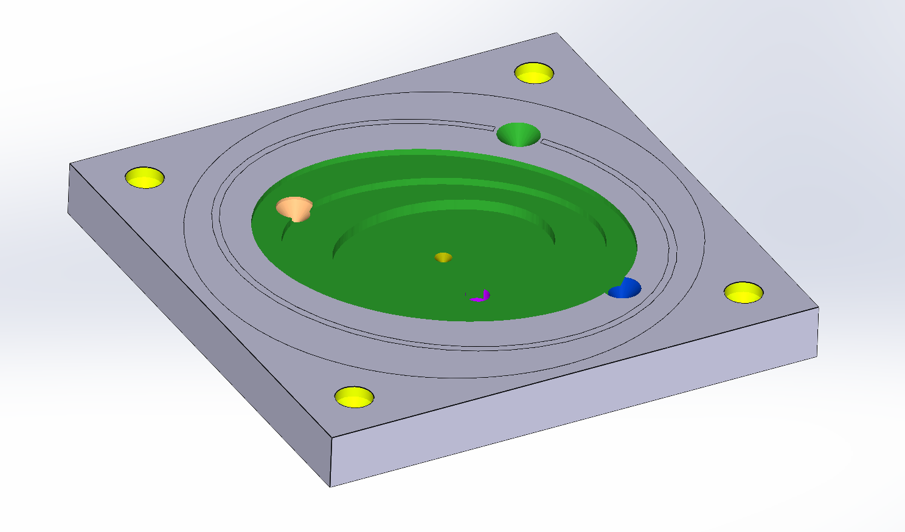
FIRST CAM ATTEMPT
LESSONS LEARNED
Drilling is a very fast and effective way to remove material
Wall features that extruded from the slanted face are very difficult to machine
Very shallow slated surfaces cannot be machined in CAM

Slide 4
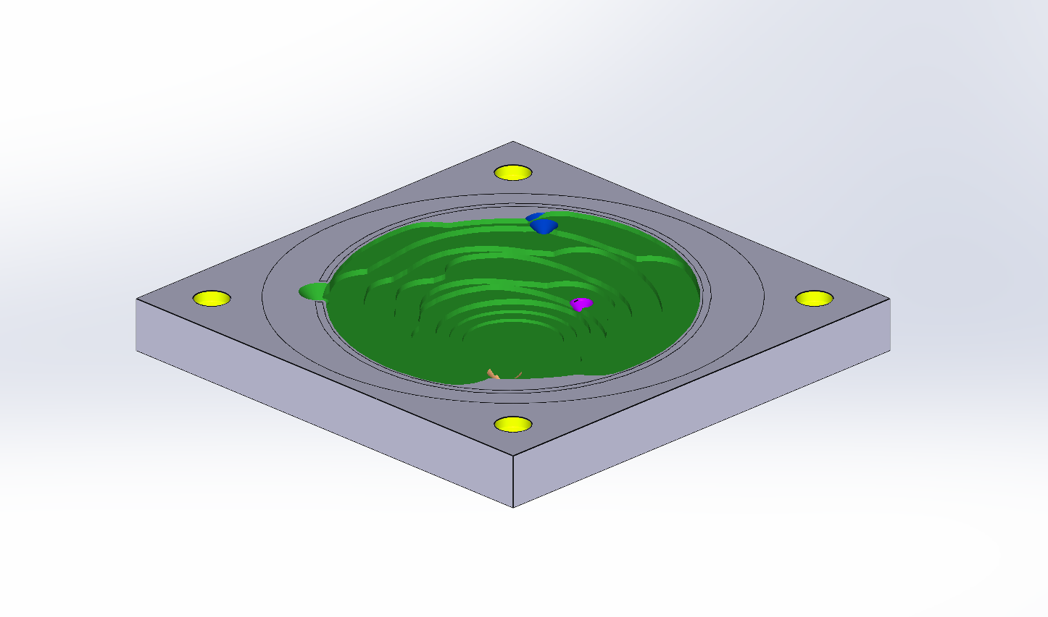
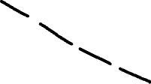

Removing Maze walls?
I considered removing the walls as they were causing the biggest CAM issues, and instead using centripetal force to get the bearings out of the gravitational pull of the sun

Slide 5
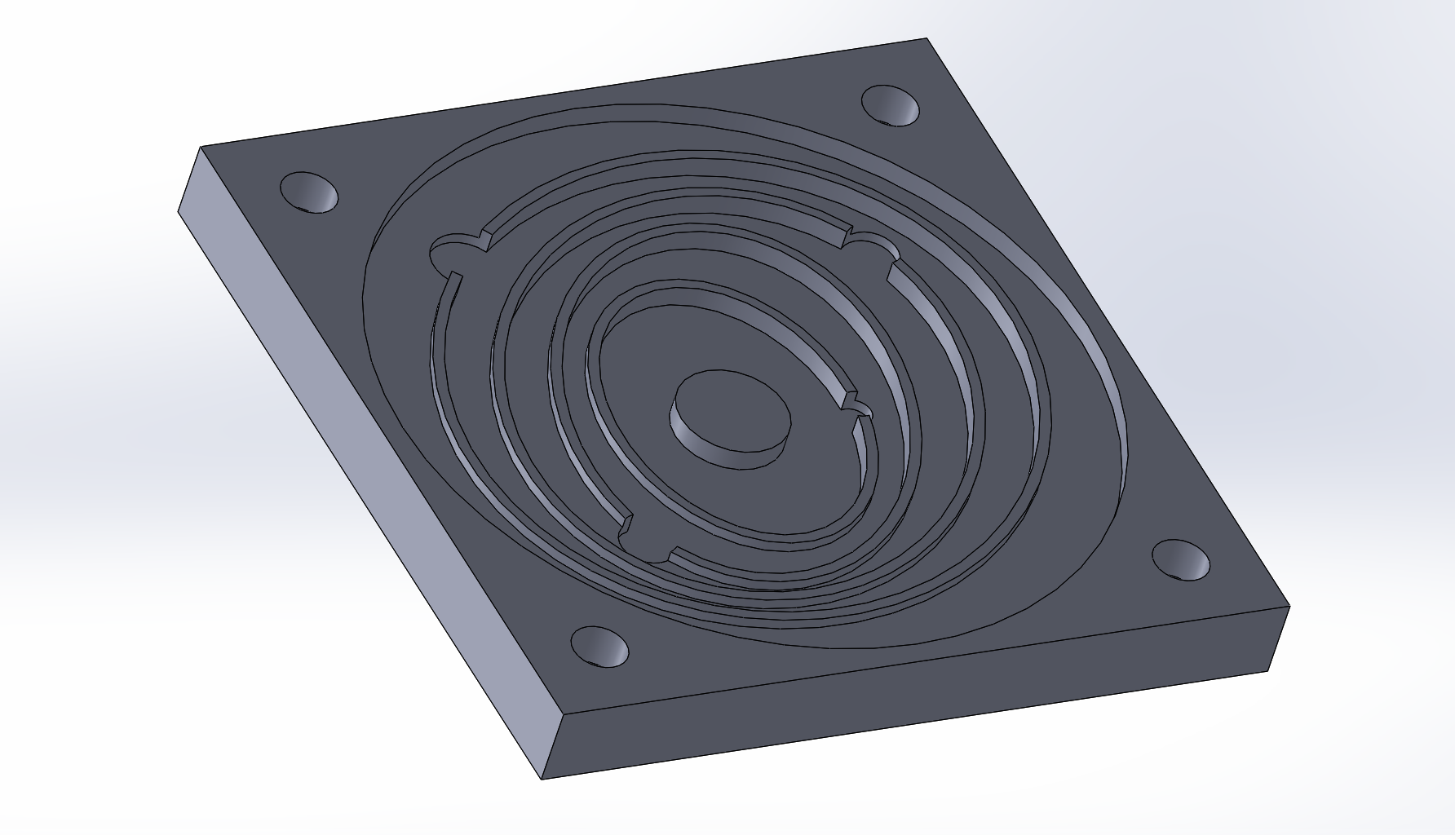
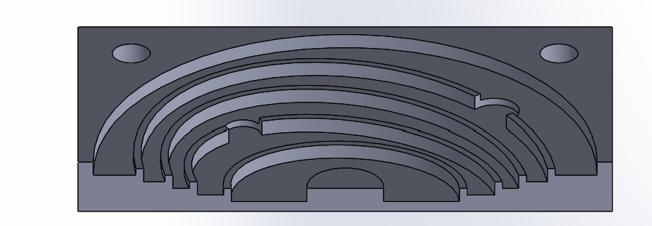
CAD Redesign – Flat Orbit Paths
KEY FEATURES
Removed the slanted face with stair-like path down to the center
Drilled holes are replaced with end milled holes which connect on orbit to another
Left stock material in the center to resemble the sun and its central position
Gravity is modelled in the difficulty in going away from the sun compared to going towards it

Slide 6
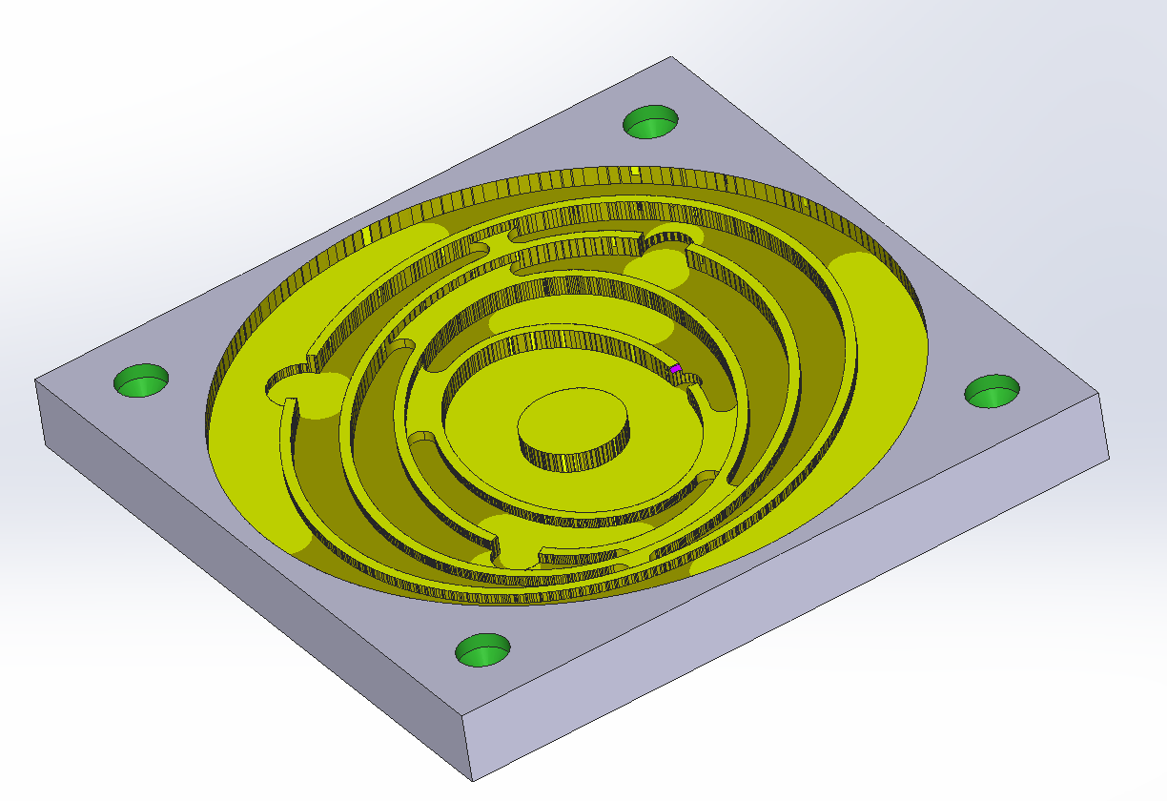
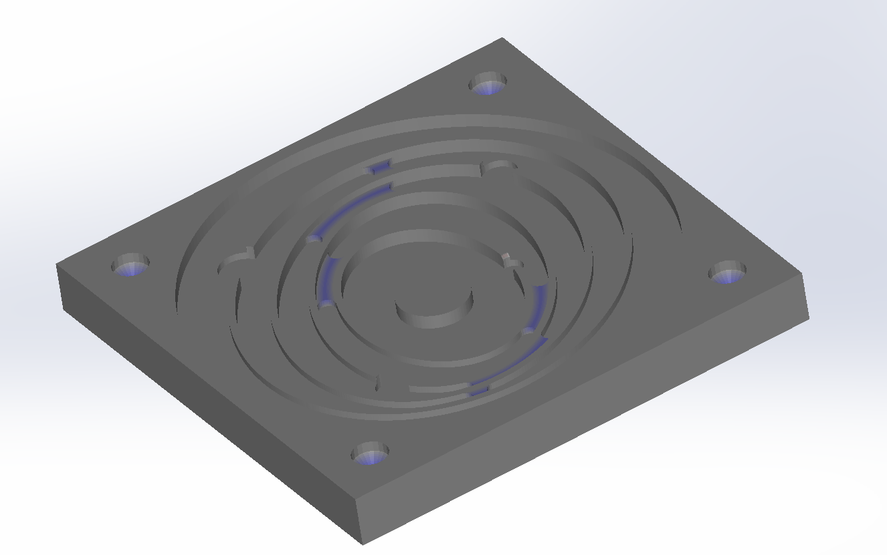
Cam of the Redesign
This CAM takes an estimated 12 minutes to complete, using 6 tools for 6 operations
However, this CAM setup leaves behind unmachined sections which reduce the aesthetic of the orbits, these are highlighted in blue
Flat surfaces are machined to a much better surface finish than the slanted surface

Slide 7
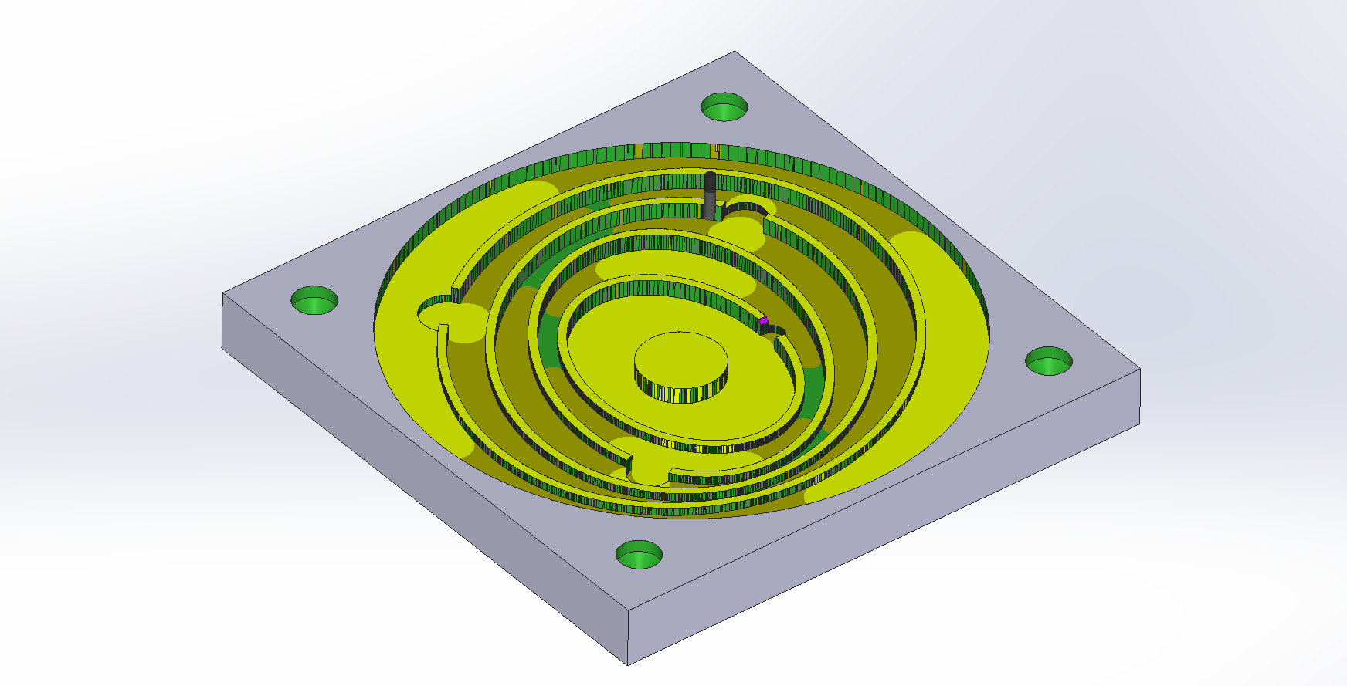
Excess Material Removal
To remove the blue sections highlighted in the previous slide, I used an 1/16 end mill, which was small enough to make the necessary changes.
This increased the machining time from 12mins to 36 mins

Slide 8
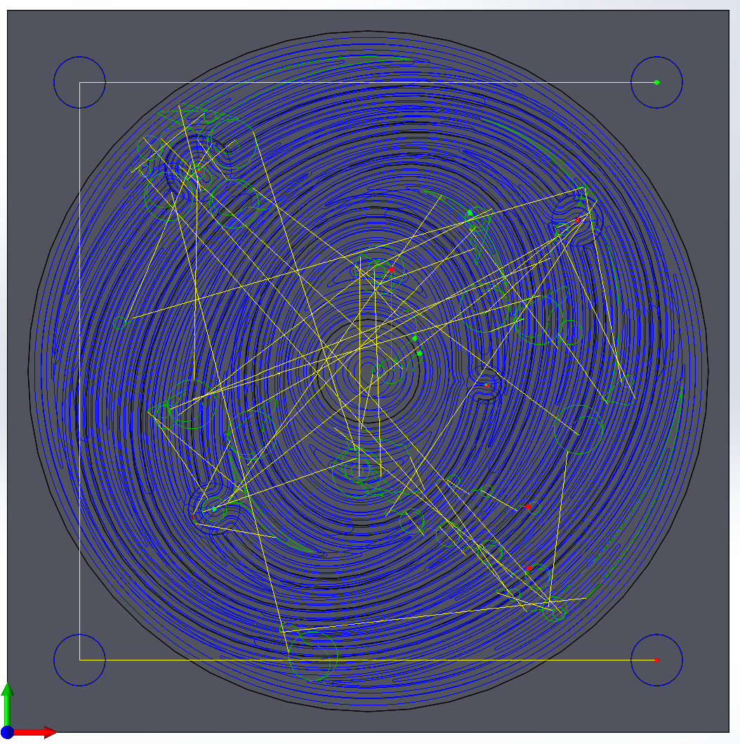
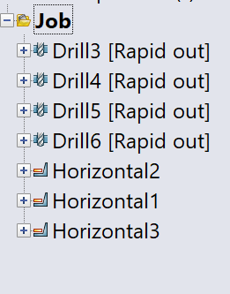
Final CAM Path

Slide 9
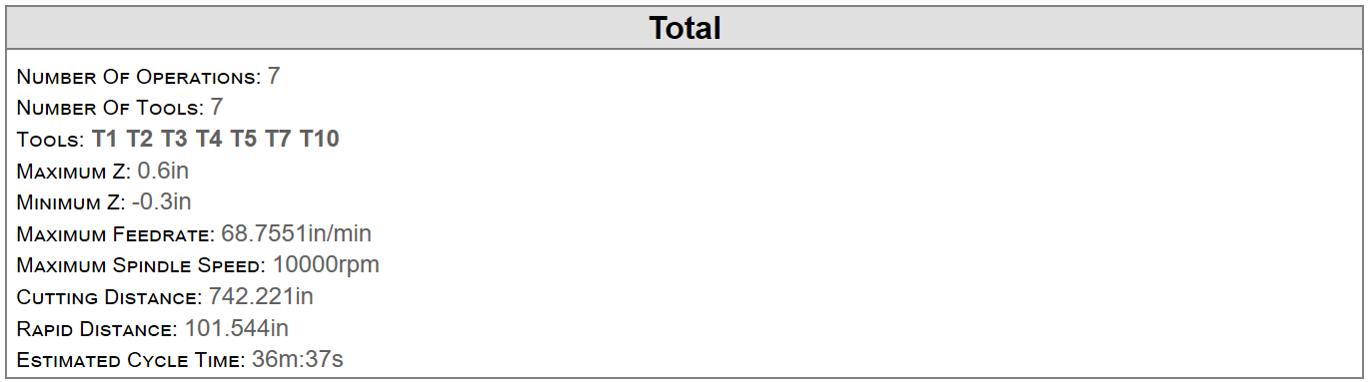
Setup Sheet for MAZE CAM Program

